Slide 1
Refinement of B-splines and NURBS

Slide 2
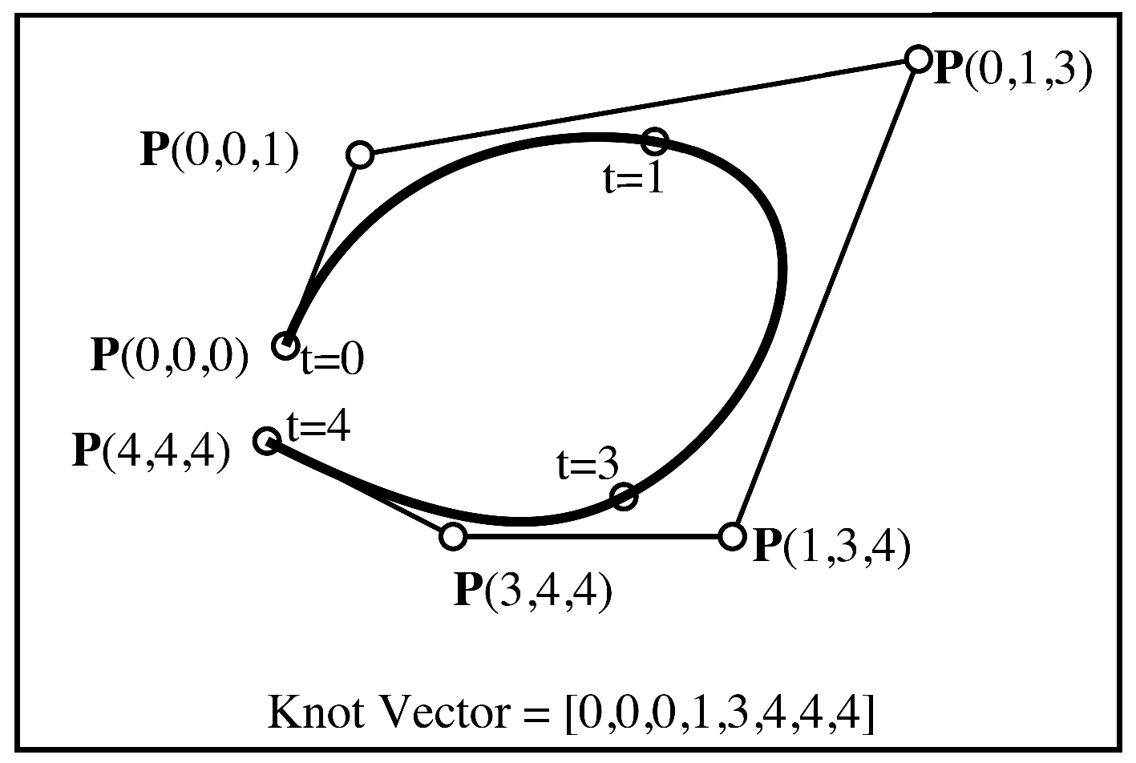

Slide 3
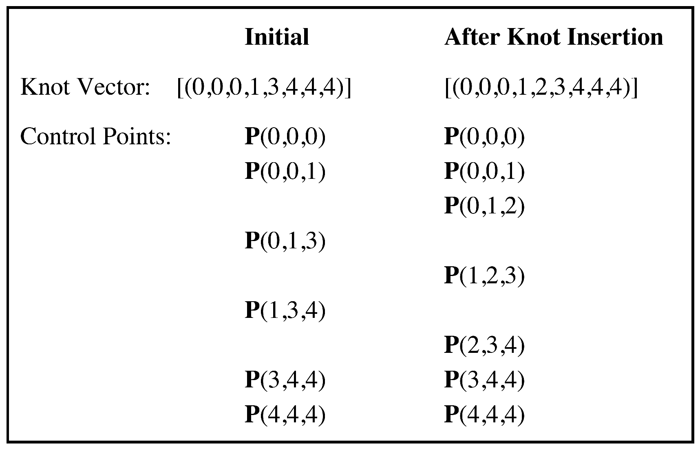

Slide 4
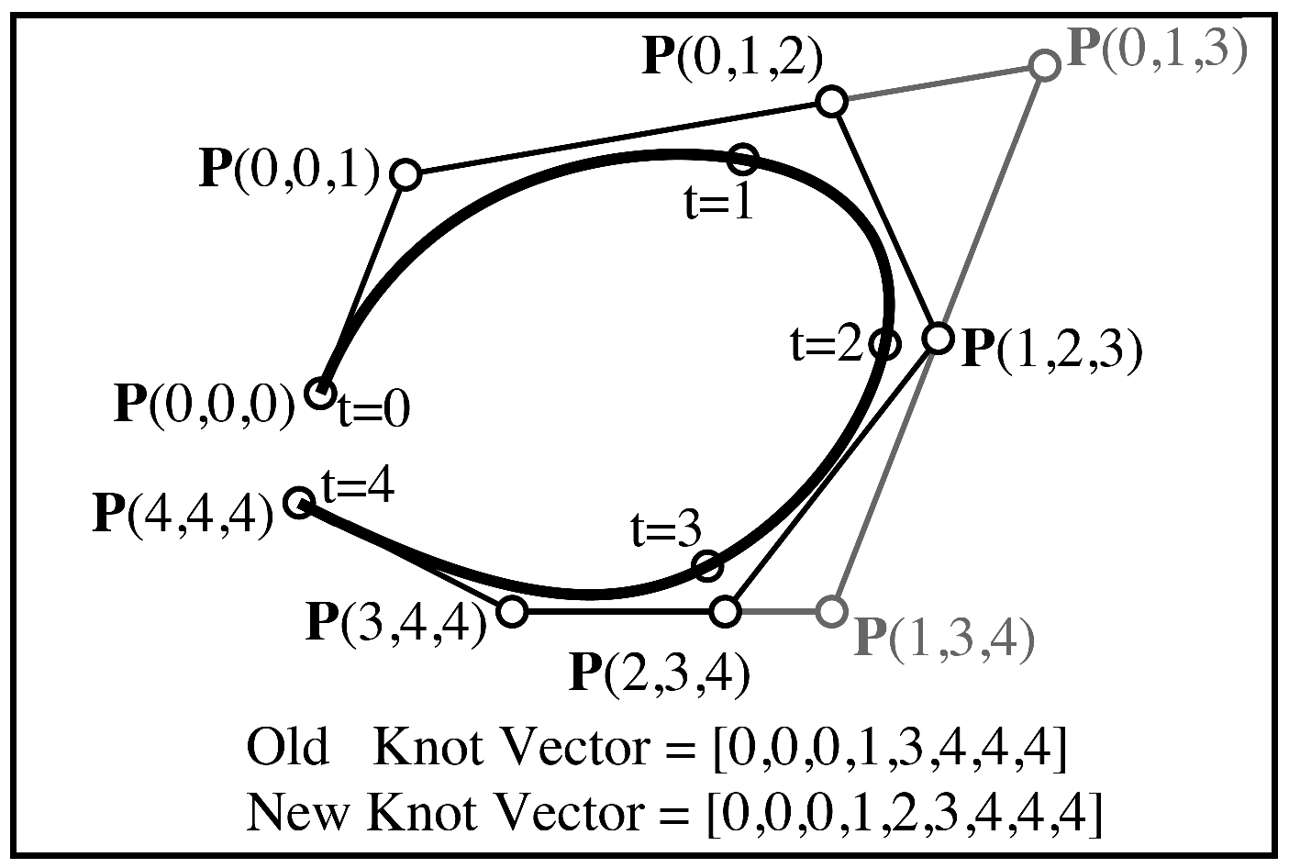

Slide 5
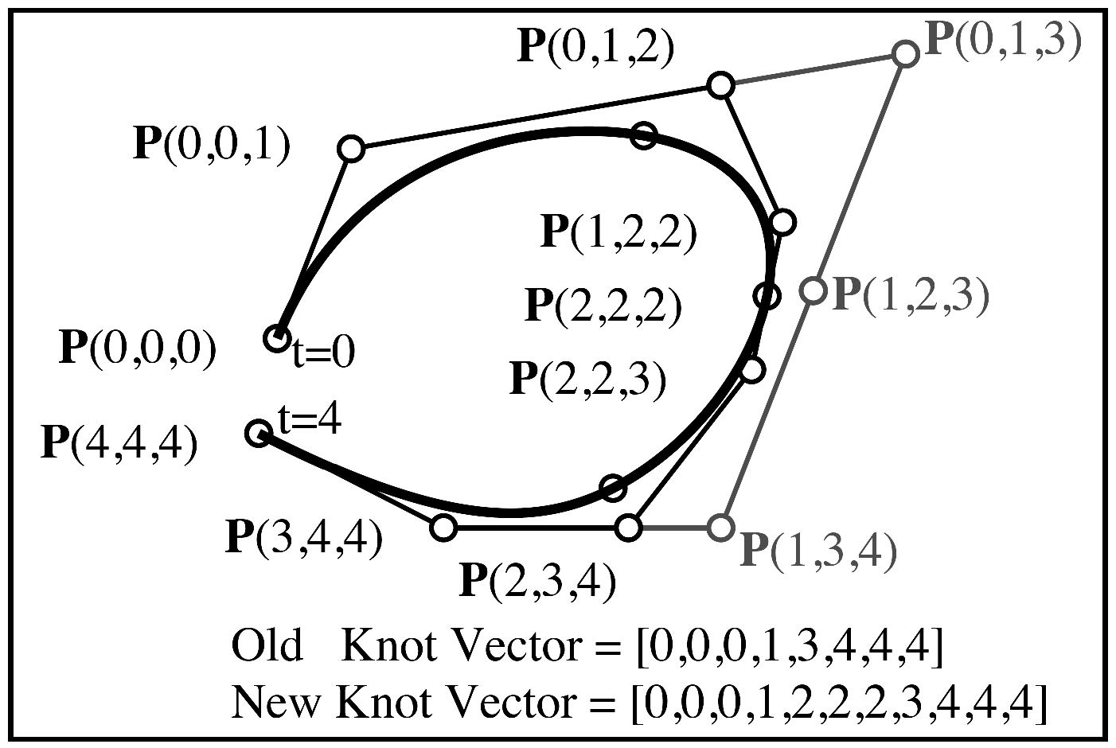

Slide 6
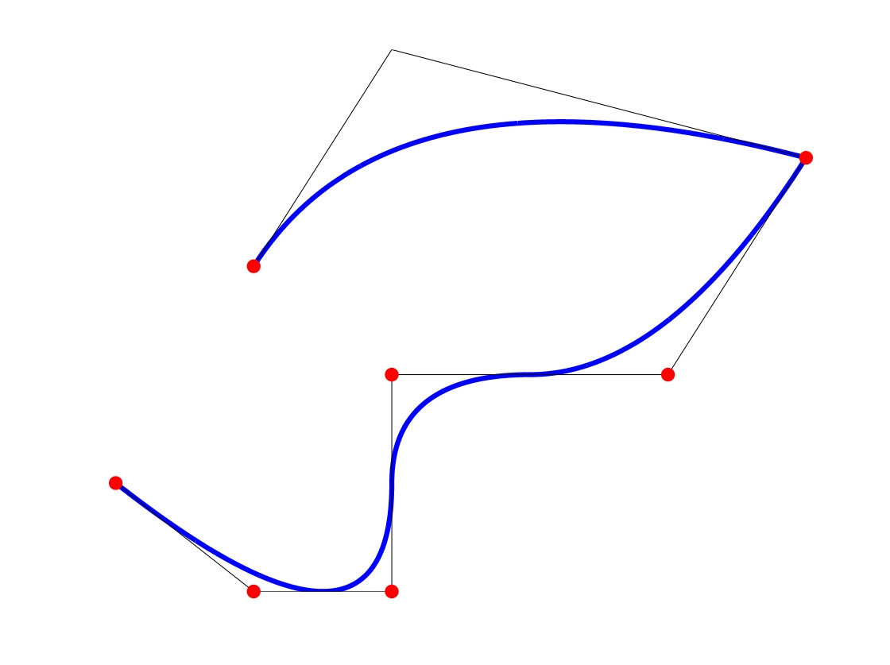
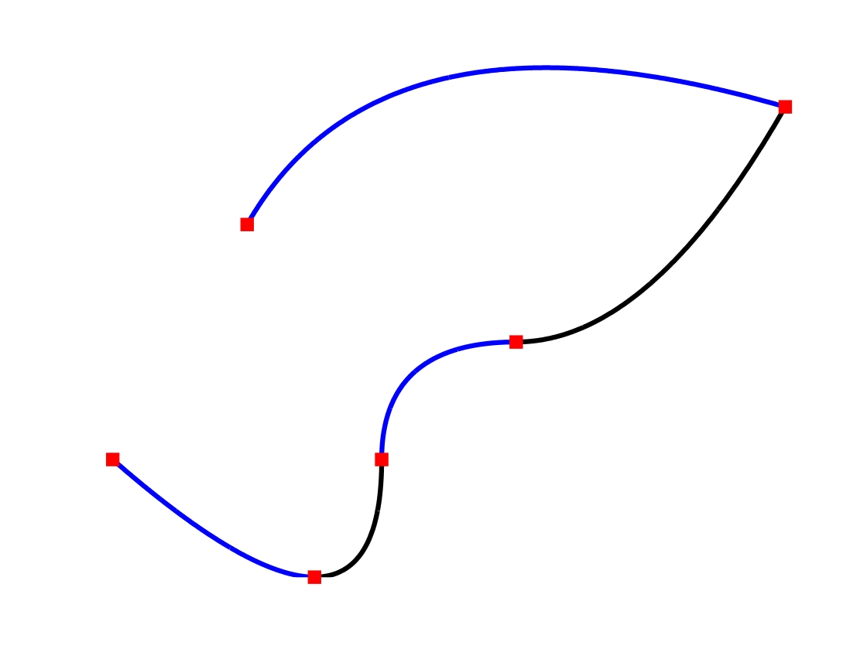
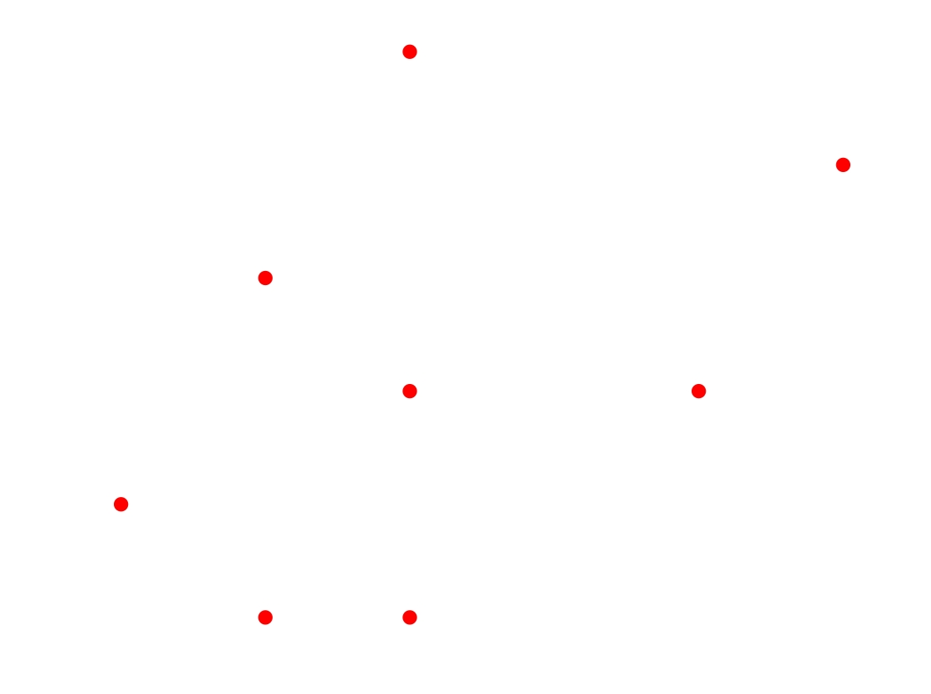
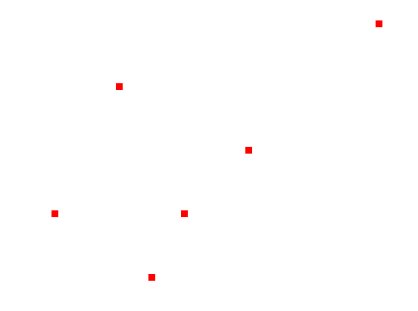
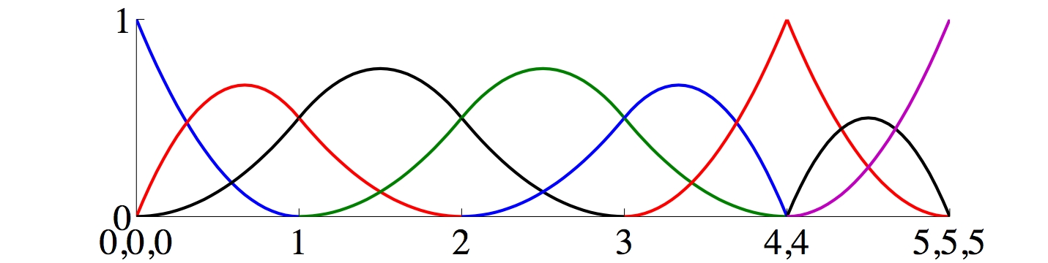
Linear interpolation of control points
yields the control polygon
4
5
3
0
2
1
- control points
- knots
Quadratic basis

Slide 7
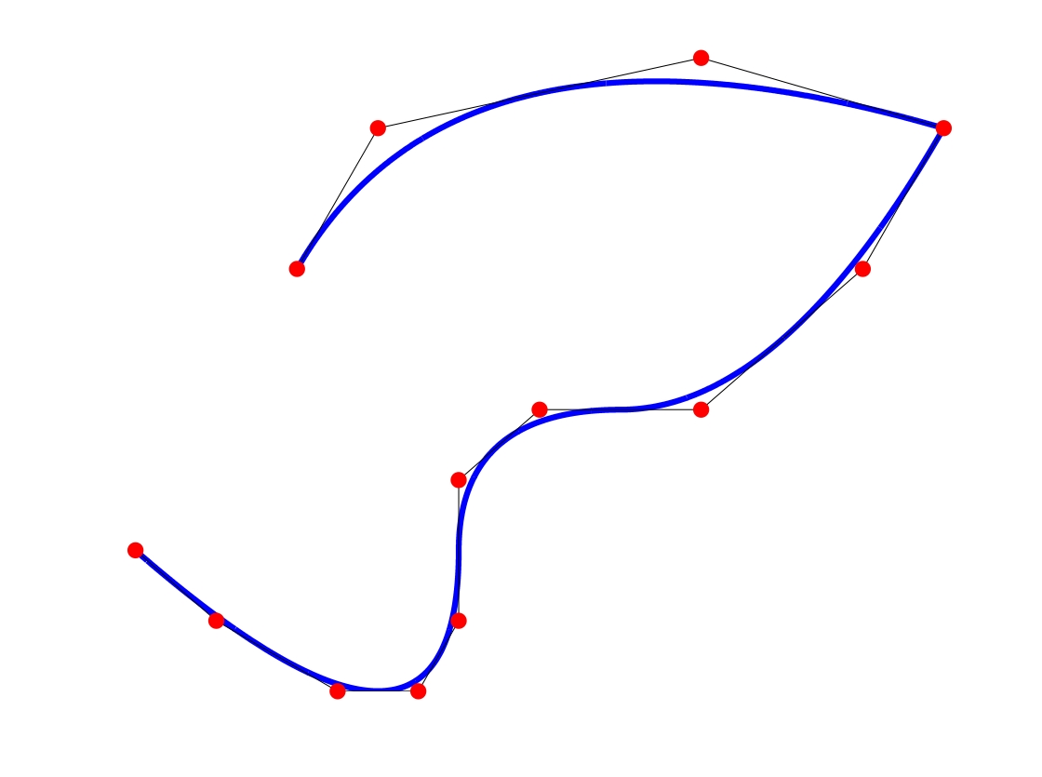
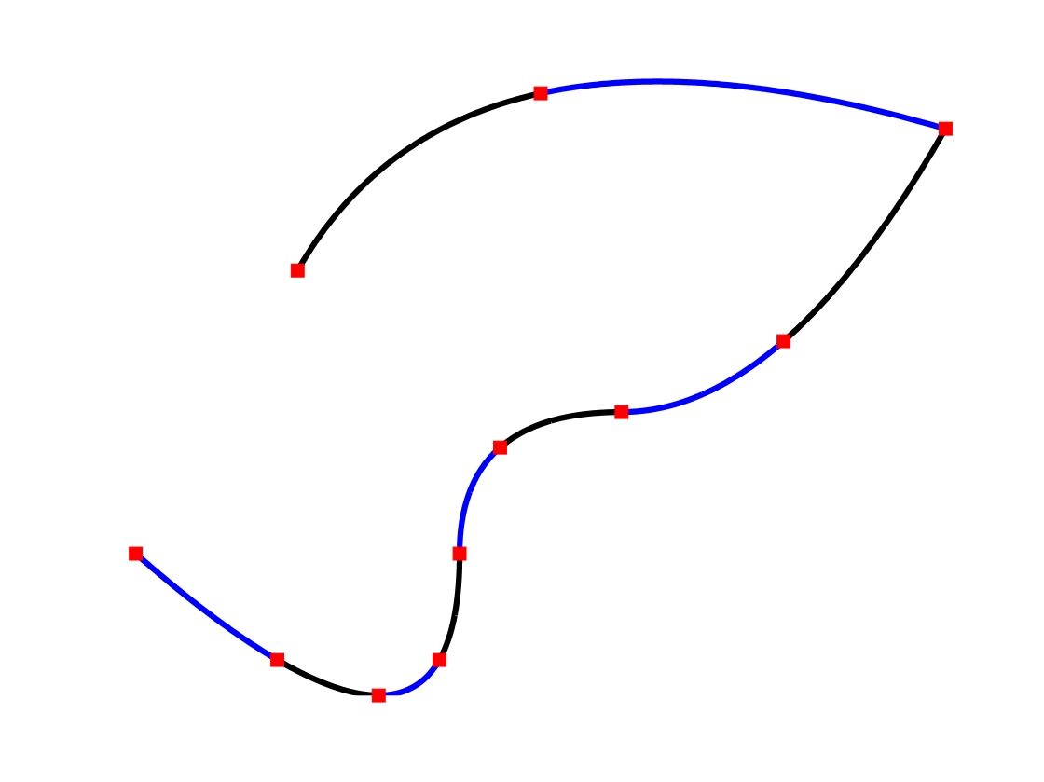
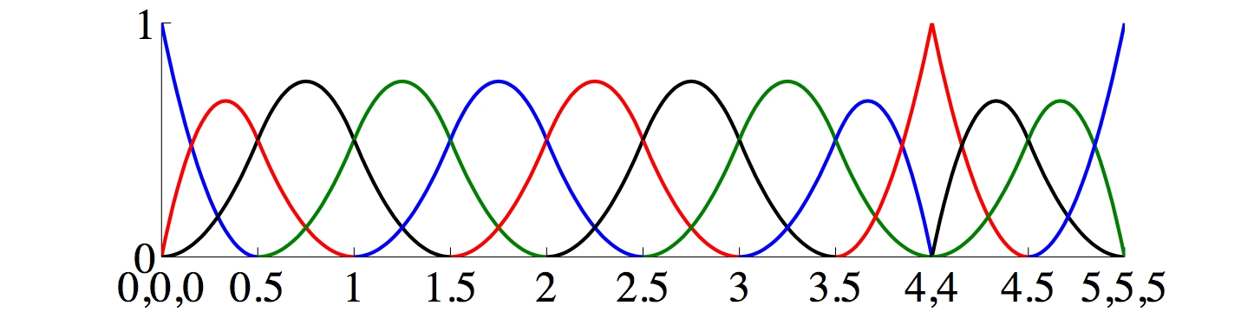
h-refined Curve
4.5
4
5
3.5
2.5
3
0
2
0.5
1.5
1
- control points
- knots
Quadratic basis

Slide 8
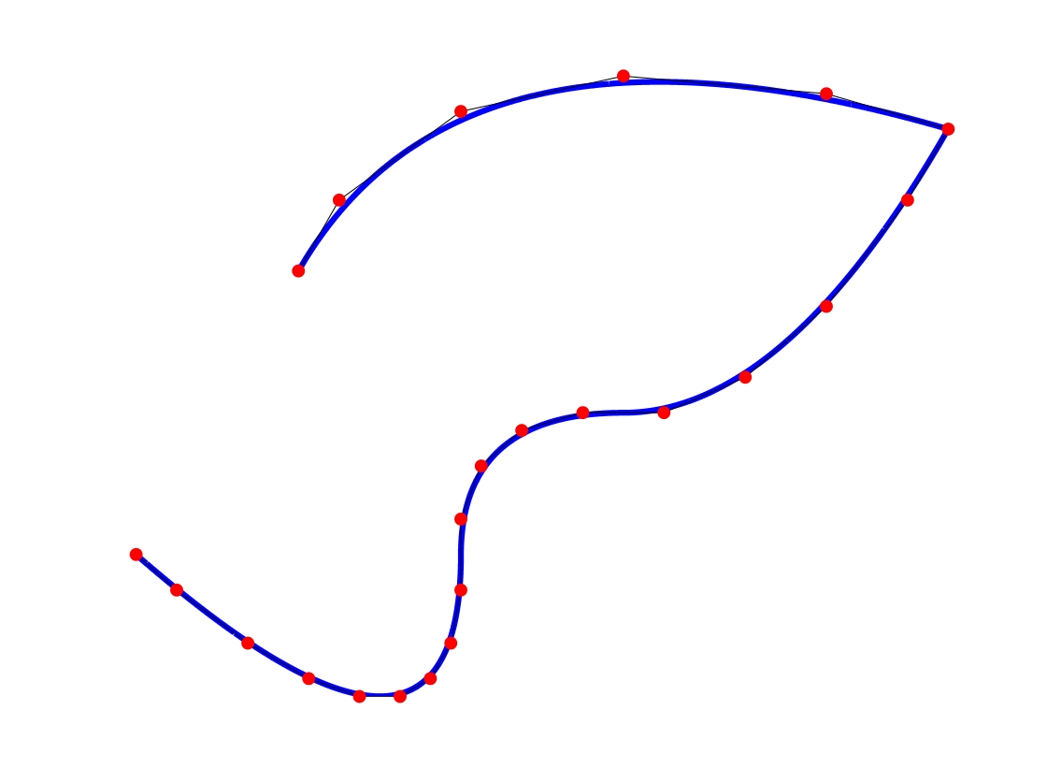
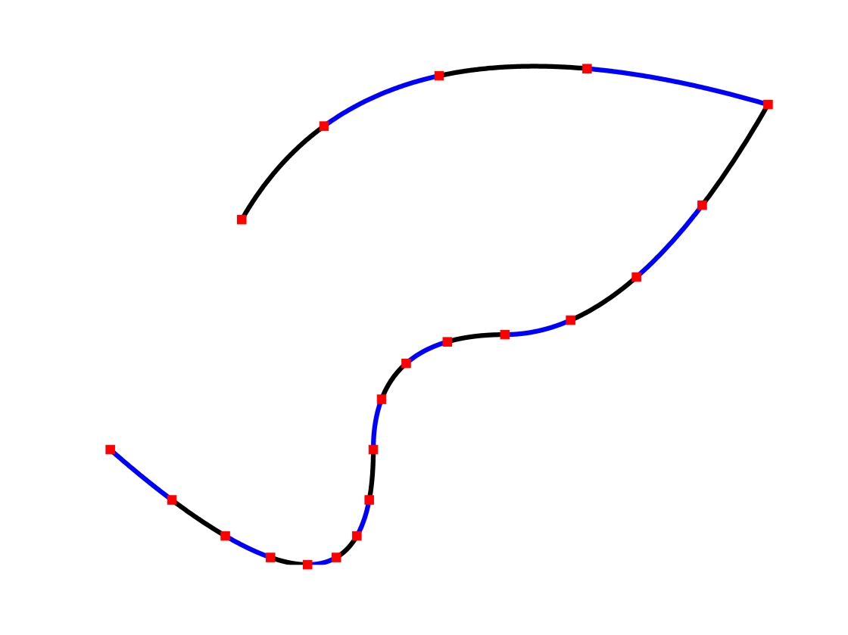
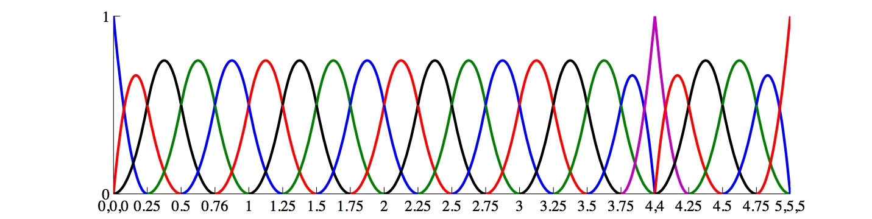
Further h-refined Curve
4.5
4.25
4.75
4
5
3.75
3.5
2.75
3
3.25
2.5
2.25
0
2
0.25
1.75
0.5
1.5
0.75
1
1.25
- control points
- knots
Quadratic basis

Slide 9
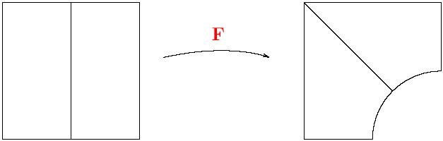
Coarsest Discretization
Patch (0,1)²
Physical domain

Slide 10
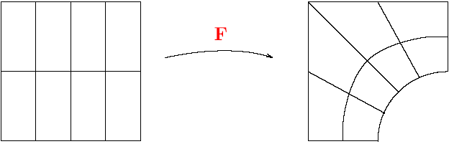
First Knot Insertion
Patch (0,1)²
Physical domain

Slide 11
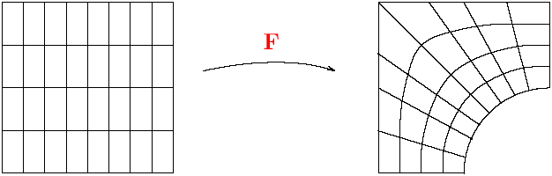
Second Knot Insertion
Patch (0,1)²
Physical domain

Slide 12

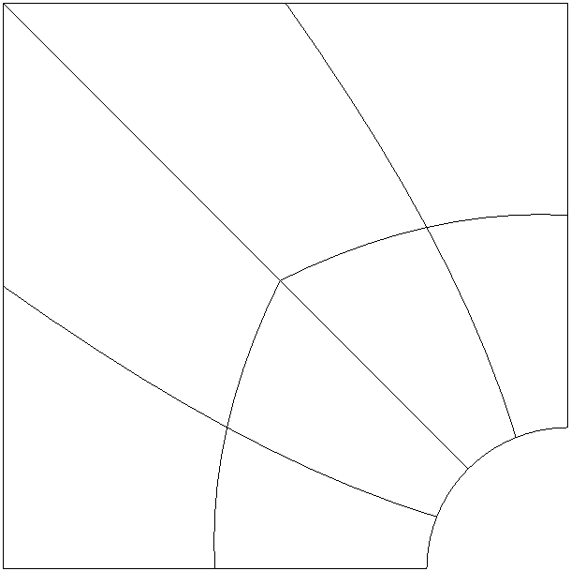
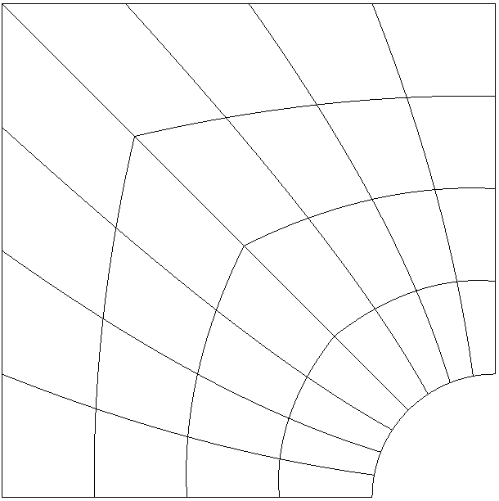
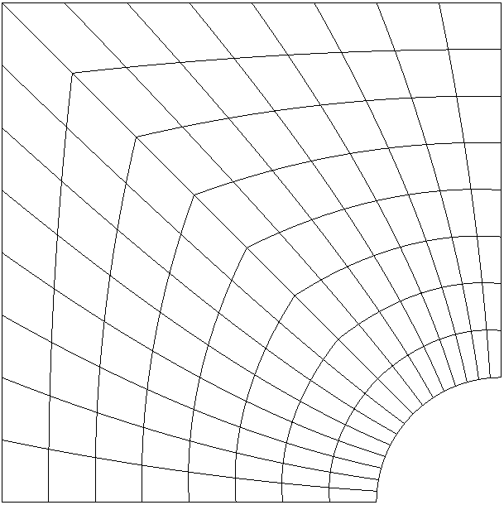
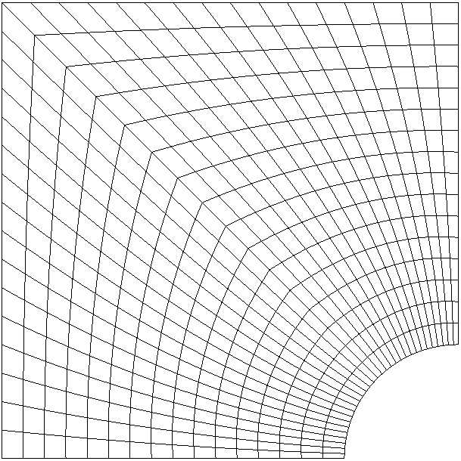
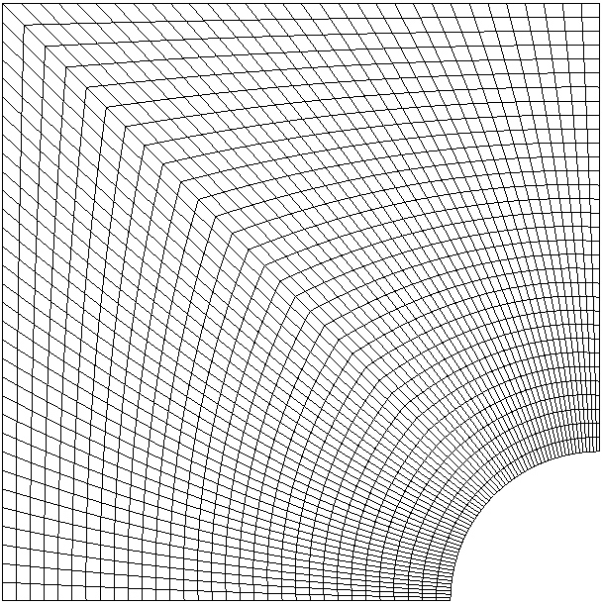
Uniformly Refined NURBS Meshes
Mesh 1
Mesh 2
Mesh 3
Mesh 4
Mesh 5
Mesh 6

Slide 13
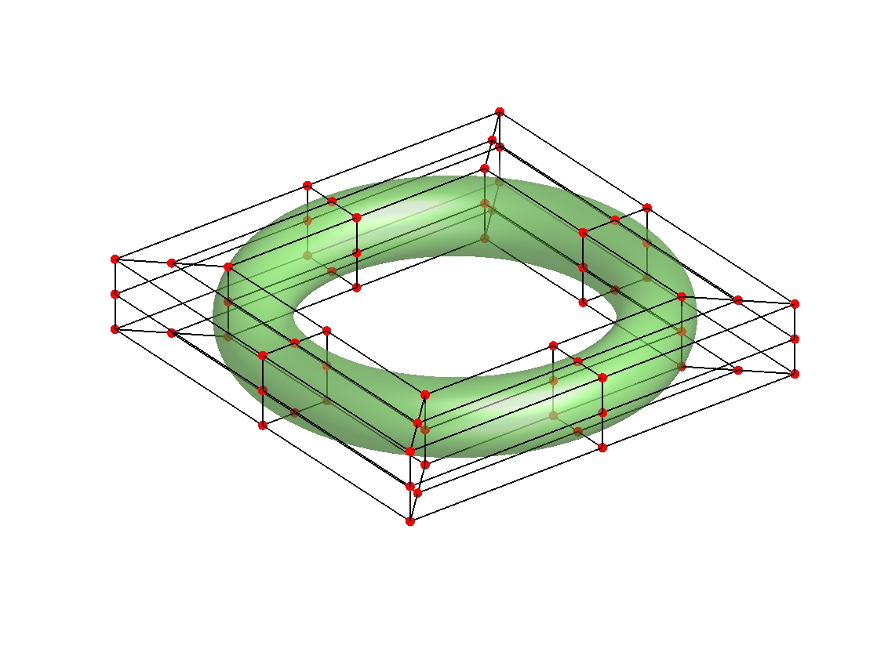
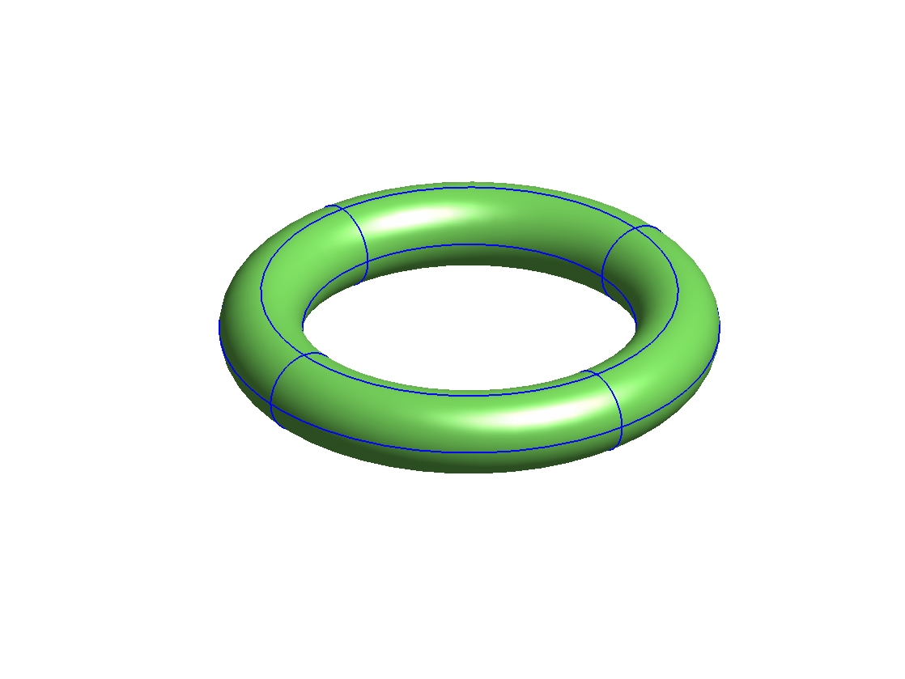
Toroidal Surface
Control net
Mesh

Slide 14
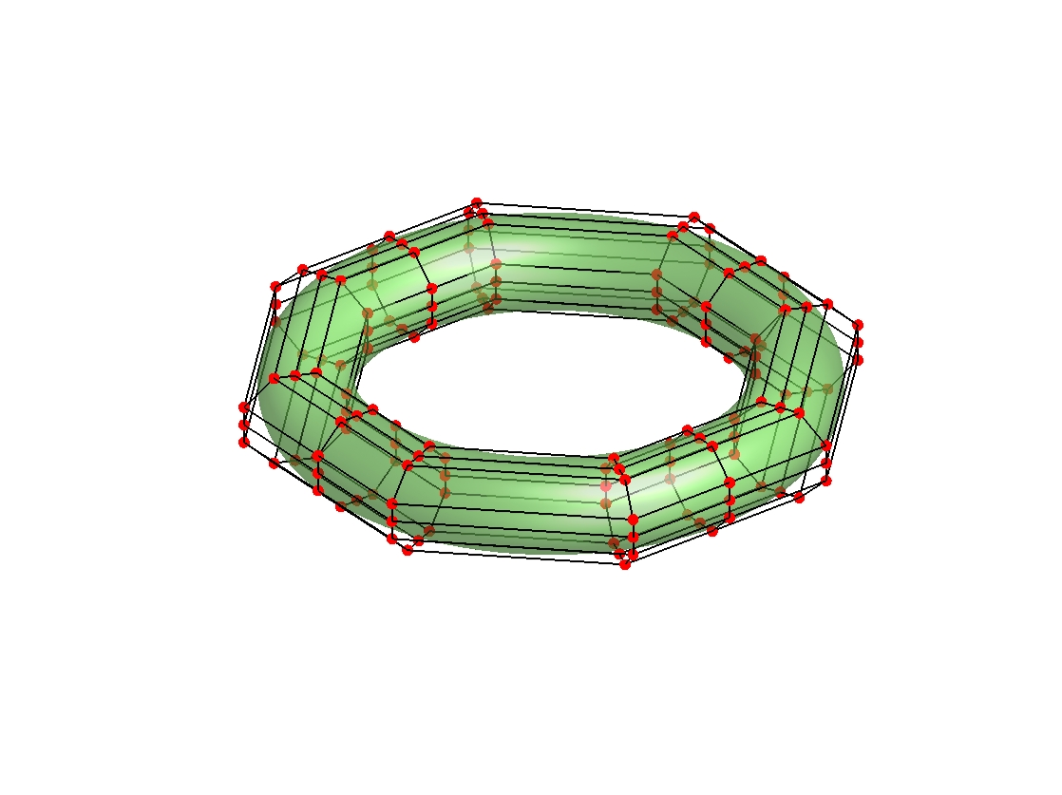
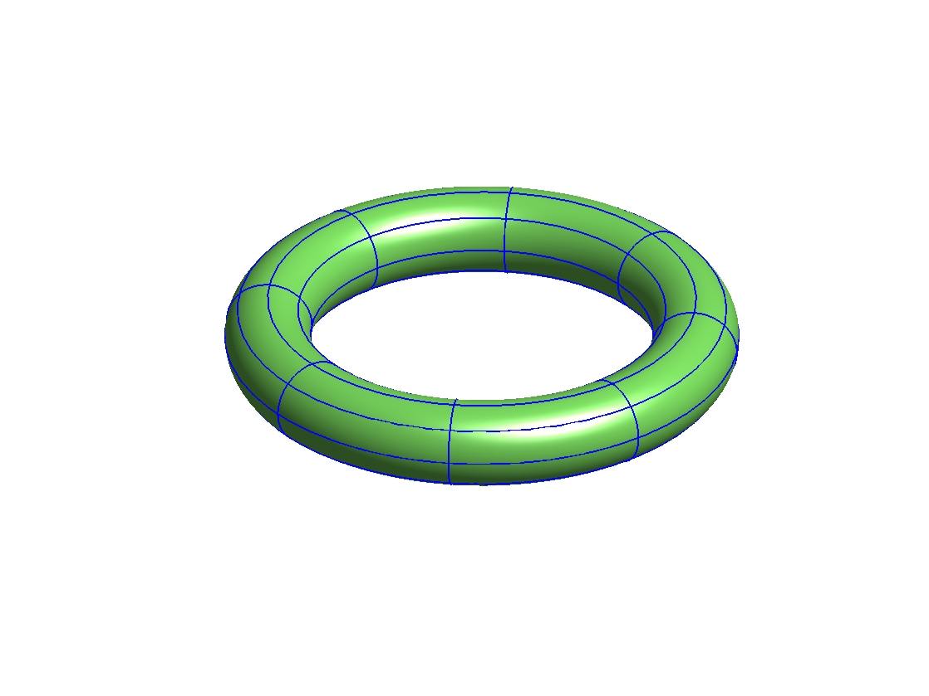
h-refined Surface
Control net
Mesh

Slide 15
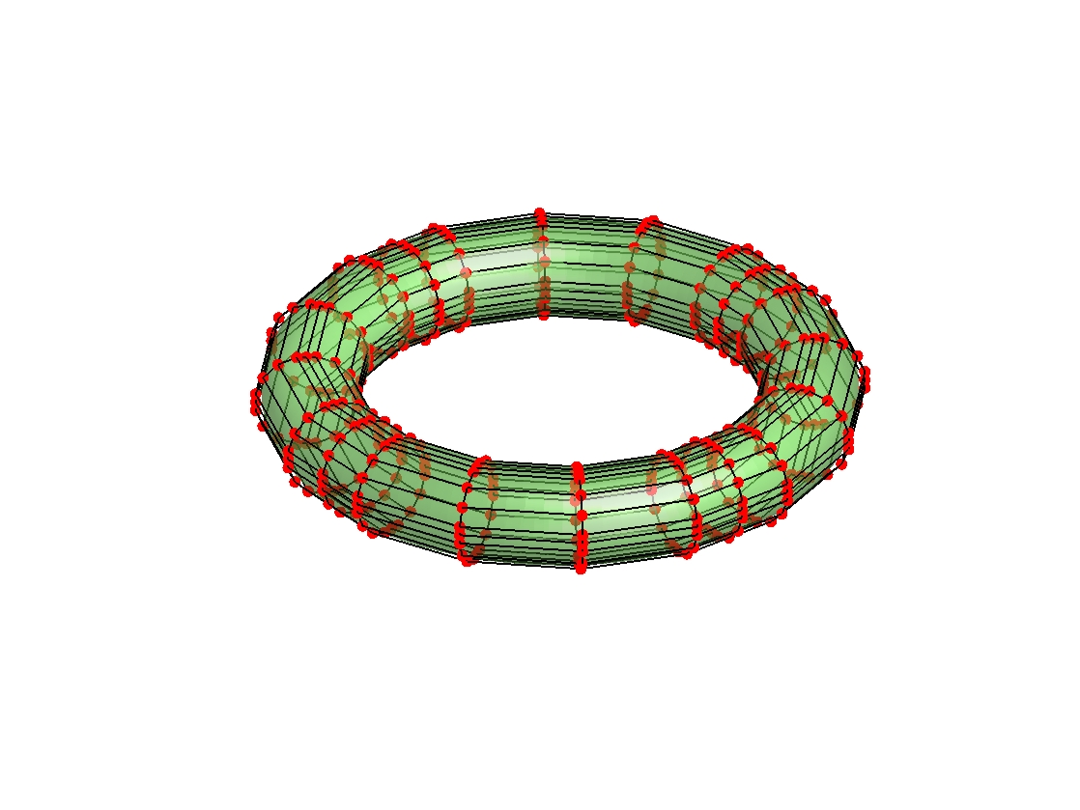
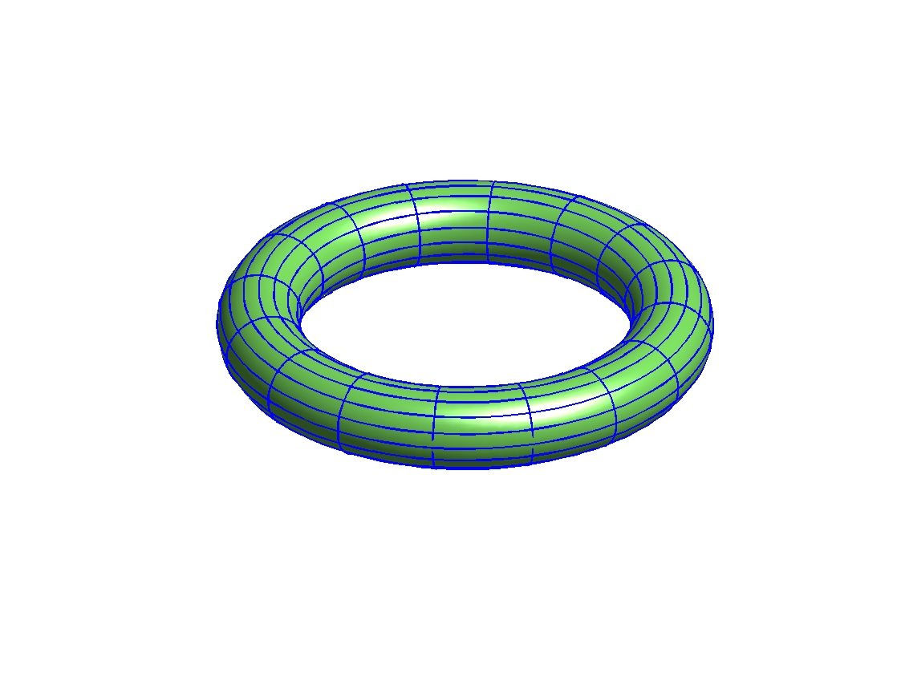
Further h-refined Surface
Control net
Mesh

Slide 16
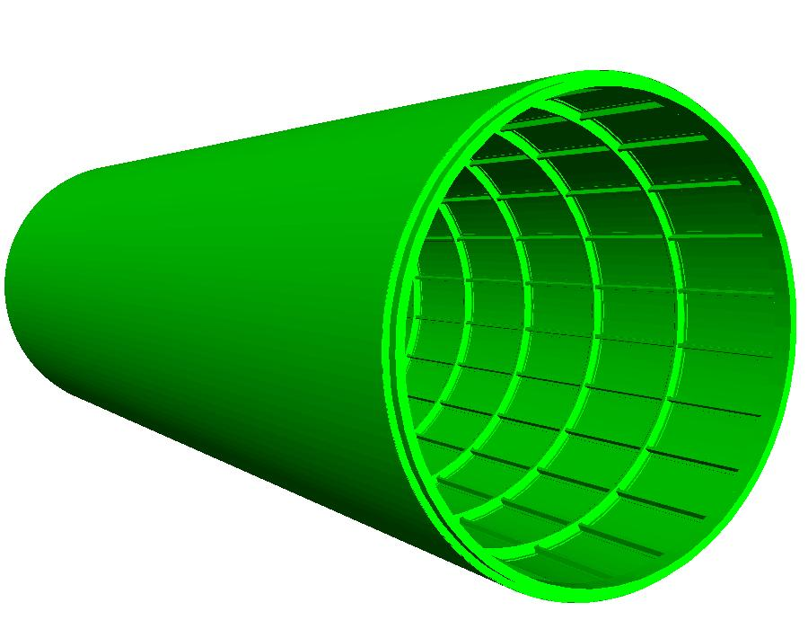
NASA ATC Frame and Skin

Slide 17

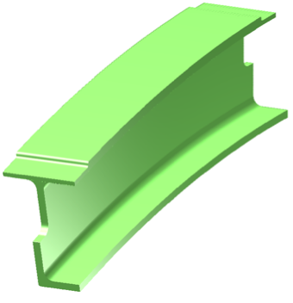
Main Rib

Slide 18
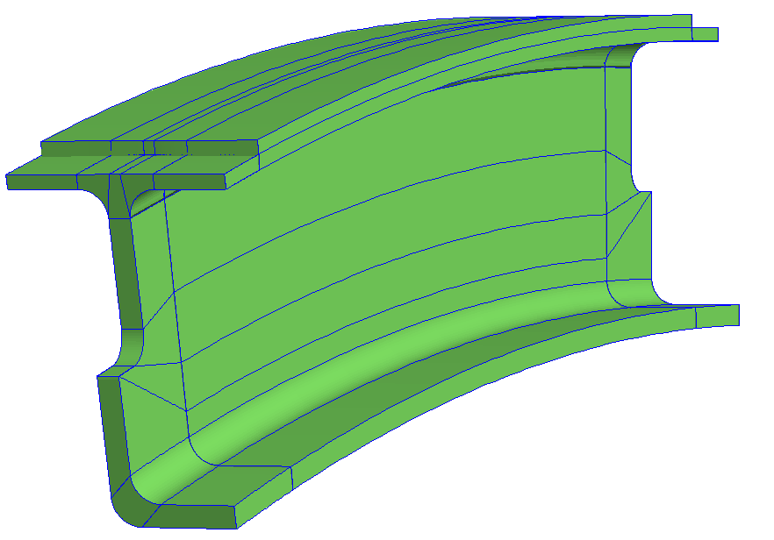
Coarsest mesh
15° segment of main rib

Slide 19
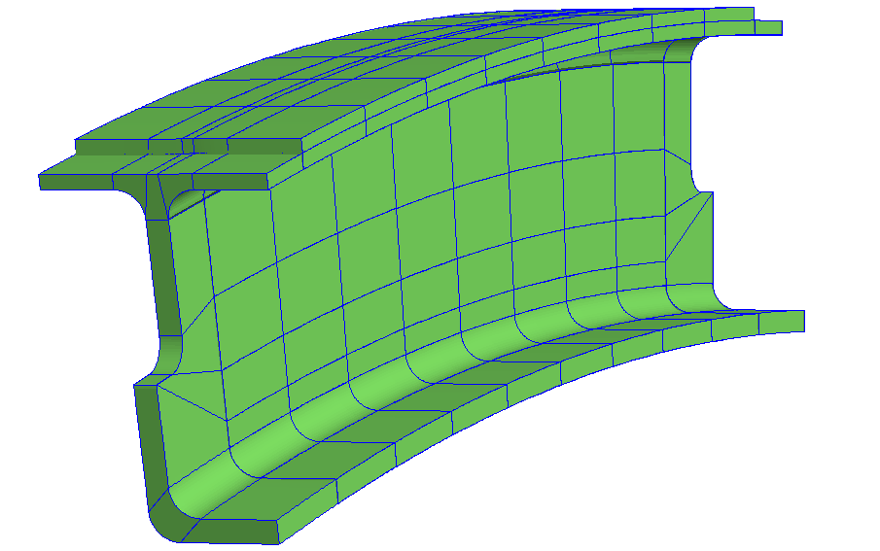
Mesh 2

Slide 20
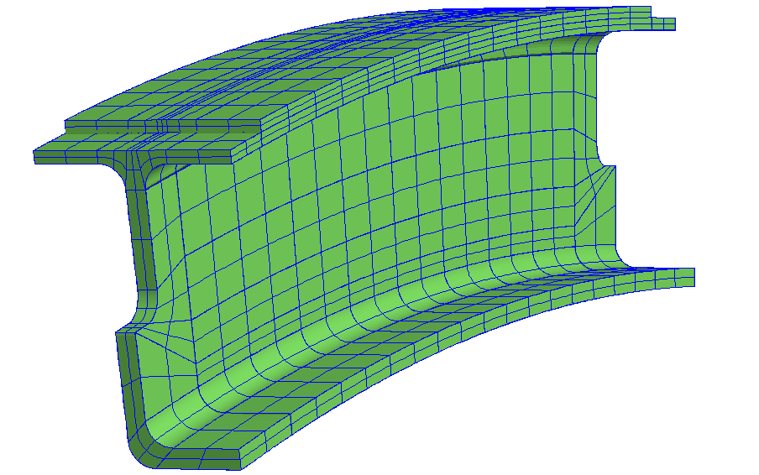
Mesh 3

Slide 21
Quadratic basis
- control points
Cubic basis

Slide 22
Linear interpolation of control points
yields the control polygon
4
5
3
0
2
1
- control points
- knots
Quadratic basis

Slide 23
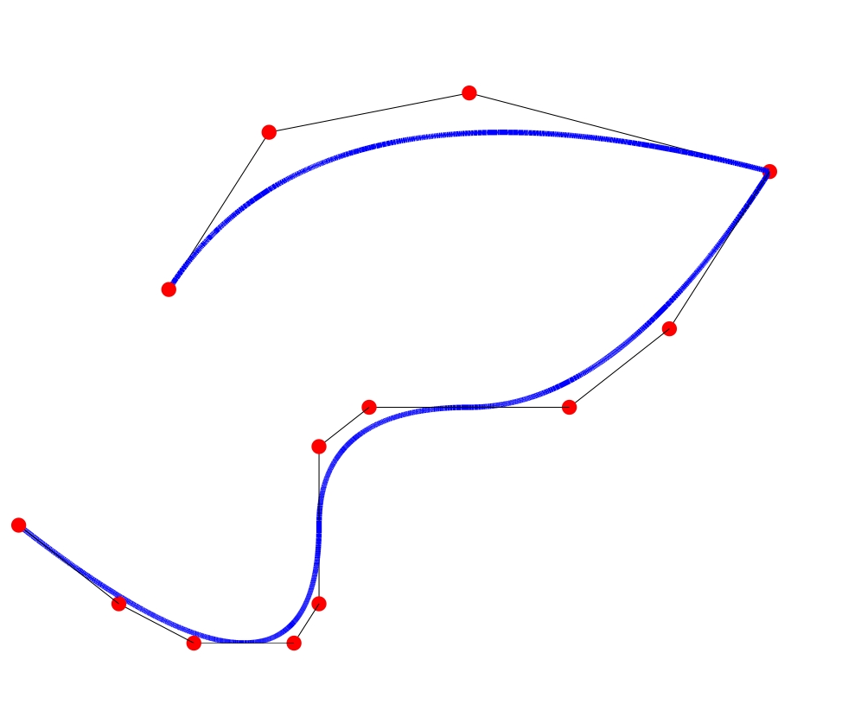
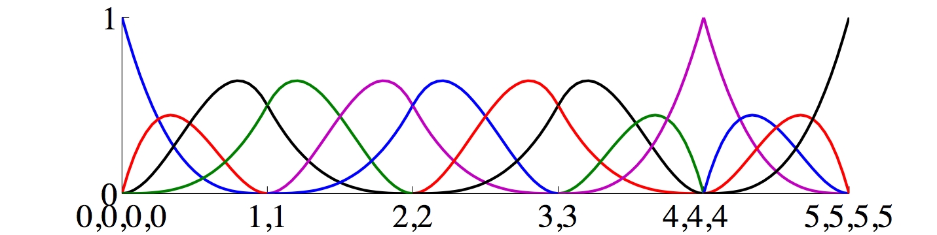
Cubic p-refined Curve
4
5
3
0
2
1
- control points
- knots
Cubic basis

Slide 24
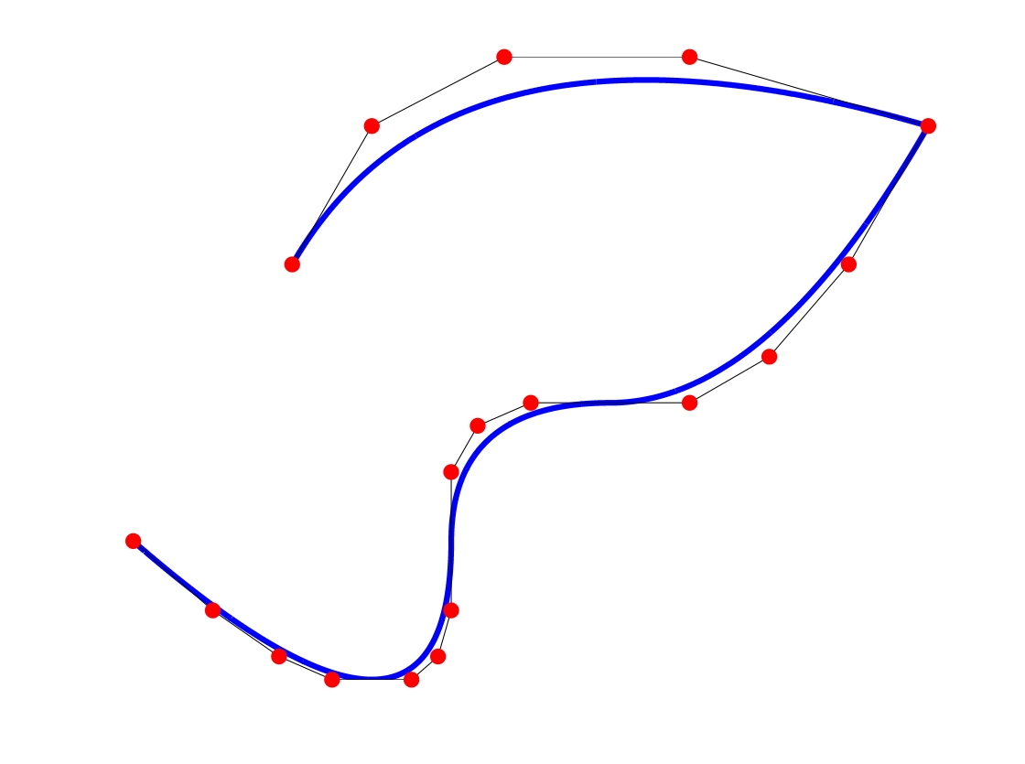
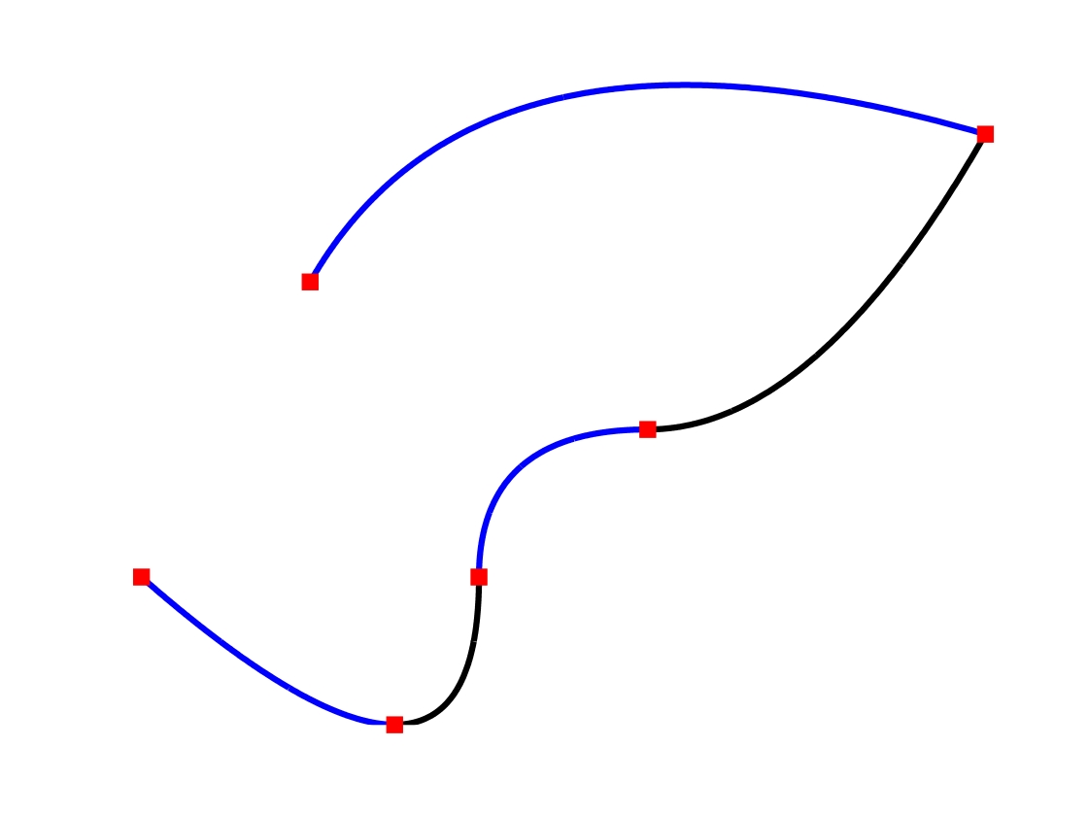
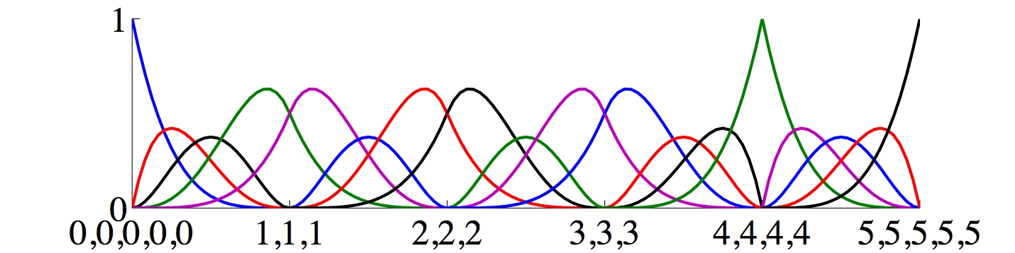
Quartic p-refined Curve
4
5
3
0
2
1
- control points
- knots
Quartic basis

Slide 25
Toroidal Surface
Control net
Mesh

Slide 26

Cubic p-refined Surface
Control net
Mesh

Slide 27
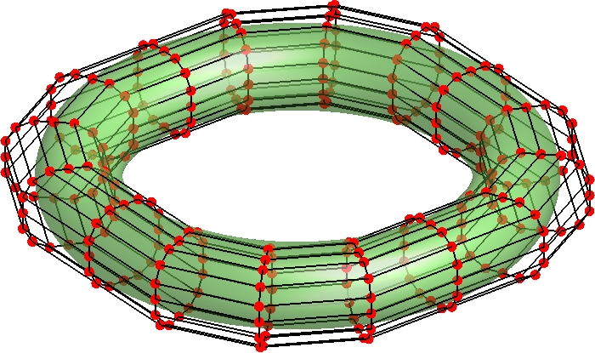
Quartic p-refined Surface
Control net
Mesh

